Slide 1
Software Architectural Design Patterns (MVC, MVP, MVVM, VIPER)
Marquez
Notes:
Hello everyone, this is Marquez who will be presenting this subject. The subject title is software architerual design patterns. Actually there are so many software architectural design patterns. Because I'm in a mobile team, I've focused on the trend patterns for mobile especially, iOS side.

Slide 2
Contents
MVC(Model-View-Controller)?
Architecture Design in iOS with an example
MVC
MVP
MVVM
Data binding
MVVM
VIPER
Our application(simplified POC)
Notes:
There may be some overlap with the contents that Dongho introduced in front of me.
When we started to study this, it is really hard to understand what those things are.
We thought it is hard because the architecture are virtual
But I believe that you will be more helpful to understand if you listen twice.
First, I will briefly introduce the ancient architecture called MVC, and I'll show you an example of how these architectures are used in iOS for the four architectures. There is a method called data binding to implement MVVM. So I'm gonna show you about the Data bingding with iOS briefly.
And finally, I will conclude our application with Objective-C by simply showing MVVM version with POC.
At any time in the middle, questions and tackles are welcome, I would like to ask you for something extra.
앞에서 동호씨가 소개해주었던 내용과 겹치는 부분이 있을 수 있으나, 두번 들으면 이해에 더 도움이 되실거라 믿고, 생략은 없되, 빠르게 진행하겠습니다.
먼저 MVC 라는 고대의 아키텍처에 대해 간단하게 소개 드리고, 네 개의 아키텍처에 대하여 iOS 에서 어떻게 이러한 아키텍처가 사용되는지 예제와 함께 설명드리도록 하겠습니다.
그리고 마지막으로 Objective-C 로 구성된 저희의 어플리케이션에 대하여 간단하게 MVVM을 적용한 버젼을 POC로 보여드리는 것으로 마무리 하겠습니다.
중간중간에 언제든지 질문과 태클은 대 환영이며, 첨언도 잘 부탁드리겠습니다.

Slide 3
MVC (Model-View-Controller)
View
Updates
Sees
Model
Controller
Uses
Manipulates
Notes:
This is Traditional software architecture pattern, MVC.
The user gets the information through the view, the user can uses and manipulates the model through the controller, and updates the view.
It’s an early user-centric architecture, users interact with software through views and controllers, but the model is completely separate from the user.
전통적인 소프트웨어 아키텍처, MVC입니다.
유저는 뷰를 통해 정보를 얻게 되고, 컨트롤러를 통해 모델을 manipulate하고, 뷰를 업데이트하게 됩니다.
유저 중심으로 제작된 초기의 아키텍처로써, 유저는 뷰와 컨트롤러를 통해 소프트웨어와 상호작용하게 되며 모델은 유저와 완벽하게 분리 됩니다.

Slide 4
MVC (Model-View-Controller) in iOS
View
Main.storyboard
or xib
Controller
ViewController.swift
Fetch
Model
Model.swift
Model.xdatamodeld
Setup
Sees
Uses
Load
Model – The entities
View – The interface with which the user interacts
Controller – Responsible for connecting the other two pieces
Notes:
These classes are the basic design pattern of iOS with MVC.
First of all, model didn't changed at all, it exists as a seperate class with data or key objects. For iOS, it can be managed in db format by a library called core data.
Since there are too much lecture on the library called Core data, I will explain this by simply converting it into an object class.
If you're running Xcode and have maden a hello world project,
you'll be familiar with the storyboard and viewcontroller.
this MVC is set up with View and Controller connected.
Users are able to get information from the storyboard or xib file or try to touch the view directly. The controller then links the view to the model and fetches and loads them.
I hope this architecture will be familiar to you everyone, because now I'll show you the real code as an example.
Xcode를 실행하고 hello world를 찍어본 분이시라면 storyboard, viewcontroller 에 익숙하실 겁니다.
이러한 클래스들은 MVC pattern이 적용된 iOS의 기본 디자인 패턴입니다.
실제 이 MVC는 View와 Controller가 셋업되어 연결되어 있습니다.
유저는 스토리보드 또는 xib 파일을 통해 정보를 얻거나 앱 동작을 시도하게 됩니다.
그리고 컨트롤러는 뷰와 모델을 연결해서 패치하고 로드해주는 역할을 수행하게 됩니다.
모델이란 부분은 데이터 또는 주요 객체로써 별개의 클래스로 존재하거나,
iOS의 경우 특히 core data라는 라이브러리에 의해서 db 형태로 관리될 수 있습니다.
Core data라는 라이브러리에 대해서만도 강의가 너무 많아서 이 부분은 간단하게 객체 클래스로 변환하여 설명드리도록 하겠습니다.

Slide 5
Example…
View
Controller
Button
didTapButton
Model
Label
Person
“Marquez”
Notes:
This is the example that it only uses one button and one label.
When User tap the button, the Controller will call the function named didTapButton.
And this function will update using the model the name "Marquez". Then user can see the label throught the view.
Let's see the code.
It made by Swift and Playground on Xcode.
Don't be affraid, You don't need to see all codes, just follow the functions.
Layout code are so long because it is made by playground.

Slide 6
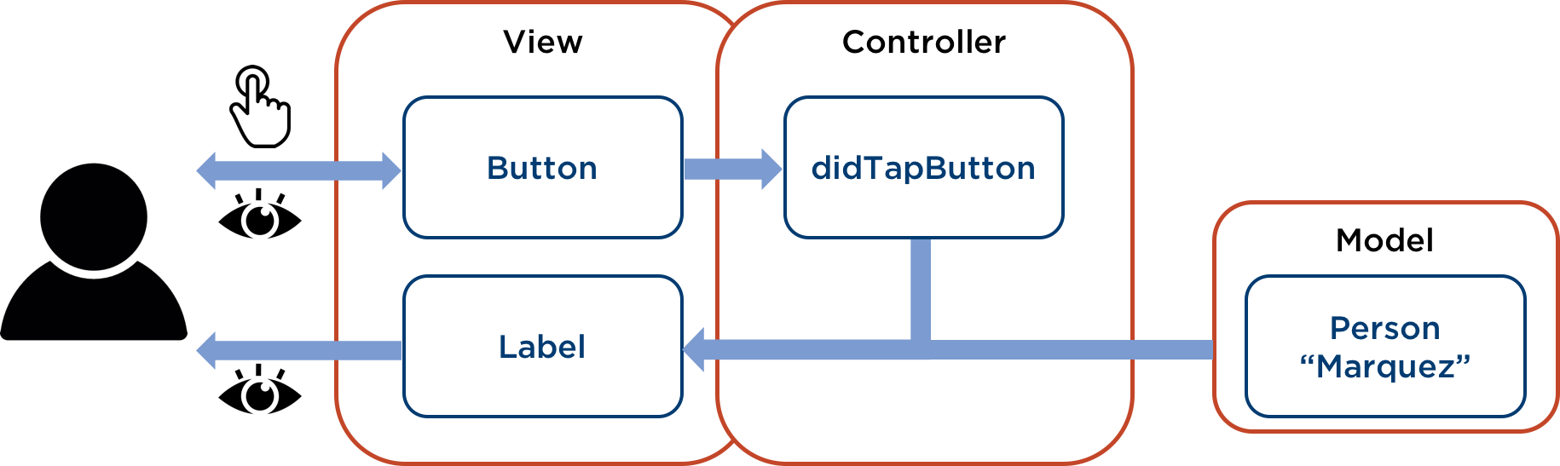
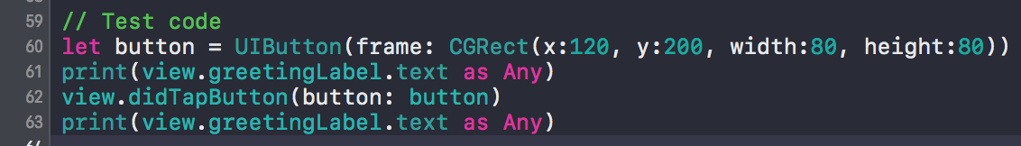
Example…
How to Test changing label??: high dependency on UI
Notes:
If you understand all features on this example,
let's think about test.
I want to test whether changing the label works well or not.
I already made a code to test.
I declared UIButton to touch directly.
After the Testing tool tap the button, greeting label will be changed.
Now, we can see cons of MVC pattern easily..
It is high dependency on UI.
When I try to test Label changes, I should declare View and Button for it.

Slide 7
Example…
How to Test changing label??: high dependency on UI
Question?
Unit test: How can we test change label directly?
Notes:
I brought a question to solve, as I do always
This logic flow has a limit to test changing label indirectly.
The logic only changes label using the button.
Then how can we test change label directly?

Slide 8
Example…
changeLabel
How to Test changing label??: high dependency on UI
Notes:
Just declare new function named changeLabel

Slide 9
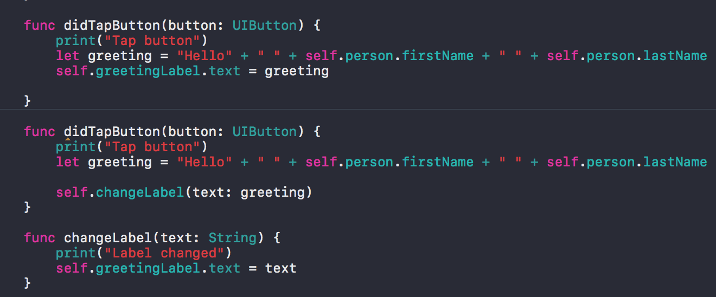
Example..
Notes:
Like this.
It has an argument with String value from Model.
When didTapButton called the function, it will set the label directly.
Let's make a test code again..

Slide 10
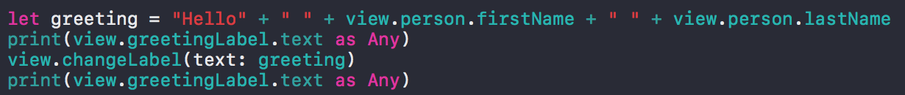
Example…
changeLabel
How to Test changing label??: still it has dependency on UI
Notes:
There is a little changes
We don't use UIButton anymore.
But still it has dependency on UI and string should call Model directly.
It is so bad... but it's not pattern's fault, because I'm not a good coder.

Slide 11
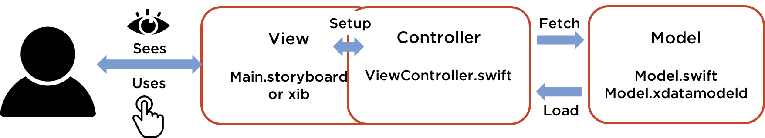
MVC
Pros
Separated Model & View
Ease of testing for Model
Cons (especially, Controller)
Difficult to test- high dependency on the iOS API(UIKit, UIView)
Modularity and flexibility- tightly bonded between View and Controller
Maintenance- a lots of codes in Controller
Notes:
The MVC pattern has the following advantages:Makes a complete distinction between model and view. This makes it easy to unit test the model, regardless of the view. However, there may be some disadvantages due to the dependency between view and controller. First, the controller is difficult to test. Unit testing is difficult because all the logic in the controller is deeply dependent on the iOS API. Secondly, there is a lack of modularity and flexibility. Because the view and controller are tightly coupled and the controller is present in the view expansion concept, there is a lack of flexibility to modify the view, such as modifying the controller.Finally, maintenance is difficult. All of the code, except the model, is gathered into the controller, which makes the controller code bloated and prone to problems.
MVC 패턴은 다음과 같은 장점을 얻습니다.
모델과 뷰를 완벽하게 구분해줍니다. 그렇기 때문에 뷰와 상관 없이 모델에 대한 단위테스트가 용이합니다.
하지만, 뷰와 컨트롤러 간의 종속 관계로 인해 몇 가지 단점을 가질 수 있습니다.
먼저, 컨트롤러의 테스트가 어렵습니다. 컨트롤러의 모든 로직이 iOS API에 깊은 의존성을 갖기 때문에 단위테스트가 어렵습니다.
두번째 모듈화와 유연성이 부족합니다. 뷰와 컨트롤러가 단단히 결합되어 있고, 뷰의 확장개념으로 컨트롤러가 존재하기 때문에, 뷰를 수정하면 컨트롤러를 수정해야하는 등 수정의 유연성이 부족합니다.
마지막으로 유지 보수가 어렵습니다. 모델을 제외한 모든 코드가 컨트롤러로 모여지기 때문에 컨트롤러 코드가 비대해지고 문제가 발생하기 쉬워집니다.

Slide 12
Massive View Controller?
Controller
Network requests
Responding to interface events
Formatting data for the interface
Accessing data models
Parsing responses
View
Model
Notes:
MVC has a nick name.Somebody called Massive View Controller.
It means every business logics are integrated only in Controller.Network, Parsing, Accessing to datamodel, formatting data, and responding user-interface events. It can be Pros and also Cons. We have to see only the business logic in Controller without others. But it makes less modularity and flexibility as I said last slide.
Then people thought about the new design pattern instead of MVC. They are MVP and MVVM

Slide 13
MVP (Model-View-Presenter) in iOS
Own & send actions
View
Main.storyboard
ViewController.swift
View <Protocol>
Presenter
ViewPresenter.swift
Presenter <Protocol>
View <Protocol>
Fetch
Model
Model.swift
Model.xdatamodeld
Sees
Uses
Update
Load
Model – The entities
View – V+VC, create virtual view to connect with presenter
Presenter – use unowned virtual view, no direct connection with view
Notes:
행동의 의도를 더 단순화하고 명확하게 만들엇습니다.

Slide 14
Example…
View
Presenter
Button
didTapButton
setGreeting
Model
Label
Virtual view
Person
“Marquez”
showGreeting

Slide 15
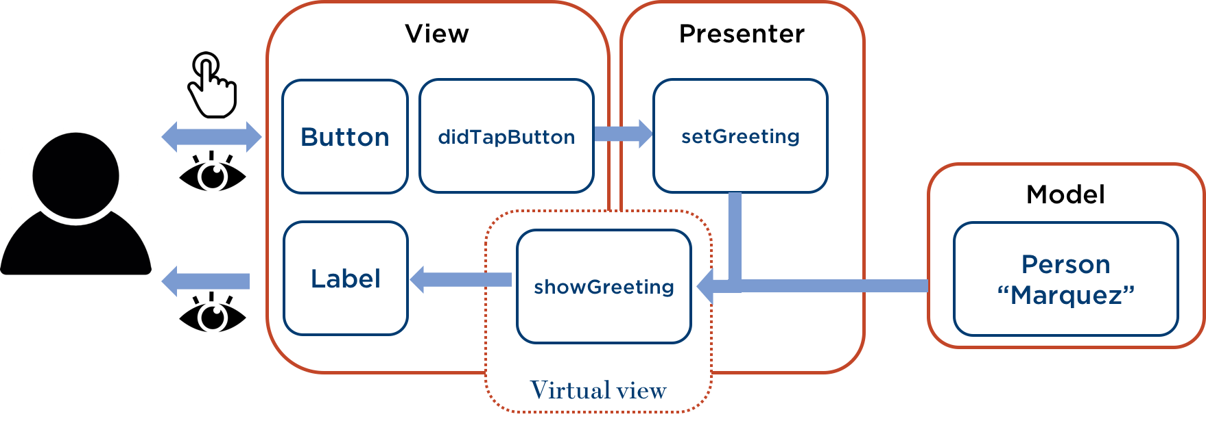
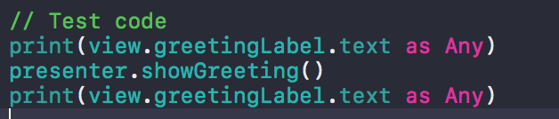
Example…
No dependency on UI, but we need virtual view or view to see

Slide 16
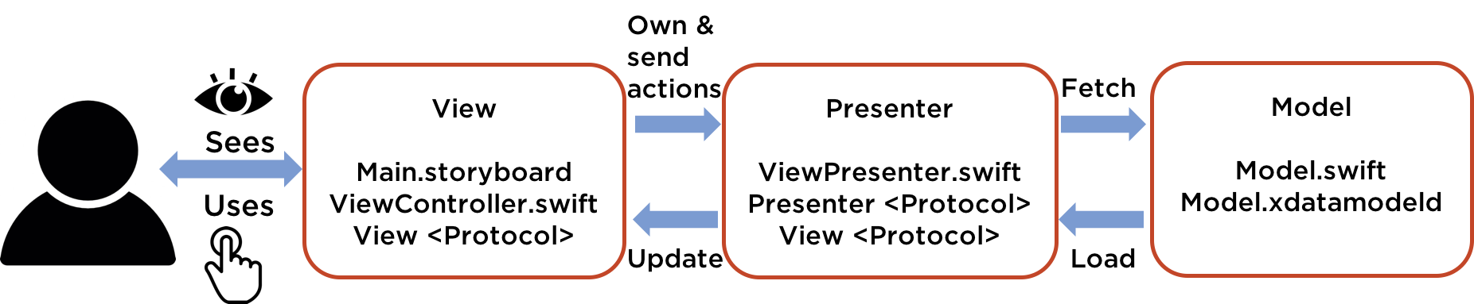
MVP
Pros
Simple and Clear for intentions of action
Pass to view only what to display, instead of how to display
Ease of testing for logics in Model, Presenter(No dependency on the iOS API)
Cons (especially, Presenter)
Maintenance- a lots of codes in Presenter
Virtual view needed
Notes:
MVC 패턴은 다음과 같은 장점을 얻습니다.
모델과 뷰를 완벽하게 구분해줍니다. 그렇기 때문에 뷰와 상관 없이 모델에 대한 단위테스트가 용이합니다.
하지만, 뷰와 컨트롤러 간의 종속 관계로 인해 몇 가지 단점을 가질 수 있습니다.
먼저, 컨트롤러의 테스트가 어렵습니다. 컨트롤러의 모든 로직이 iOS API에 깊은 의존성을 갖기 때문에 단위테스트가 어렵습니다.
두번째 모듈화와 유연성이 부족합니다. 뷰와 컨트롤러가 단단히 결합되어 있고, 뷰의 확장개념으로 컨트롤러가 존재하기 때문에, 뷰를 수정하면 컨트롤러를 수정해야하는 등 수정의 유연성이 부족합니다.
마지막으로 유지 보수가 어렵습니다. 모델을 제외한 모든 코드가 컨트롤러로 모여지기 때문에 컨트롤러 코드가 비대해지고 문제가 발생하기 쉬워집니다.

Slide 17
MVVM(Model-View-ViewModel)
View
Main.storyboard
ViewController.swift
Owns
ViewModel
ViewModel.swift
ViewModel<protocol>
Fetch
Model
Model.swift
Model.xdatamodeld
Sees
Uses
Data &
user action
binding
Load
Model – The entities
View – Binding data&user action with ViewModel
ViewModel– wrapping view, observable data for view, hook event from view to model, no dependency for view

Slide 18
Data binding
Data binding?
Data binding is the process that establishes a connection between the application UI and business logic. If the binding has the correct settings and the data provides the proper notifications, then, when the data changes its value, the elements that are bound to the data reflect changes automatically.

Slide 19
Data binding
Data binding methods for iOS
IOS SDK framework
Objective-C: Key-Value Obseving(KVO)
Swift 3: didSet
Frameworks
Bind framework: AKABeacon, RZDataBinding
Observerble framework: ReactiveCocoa

Slide 20
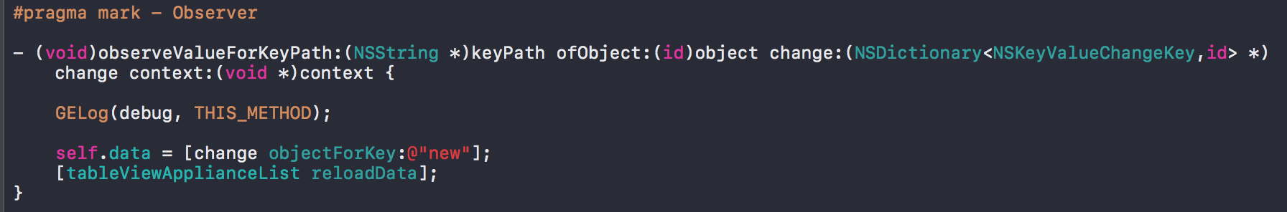
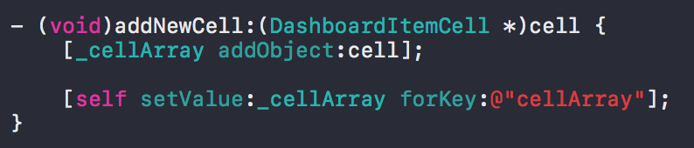
Data binding
Data binding for Objective-C: KVO

Slide 21
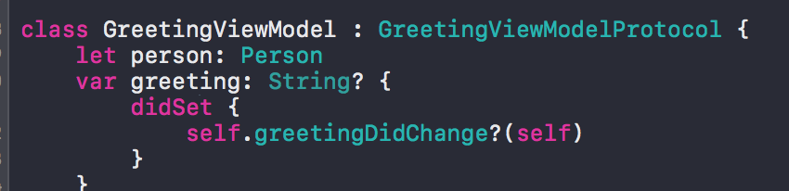
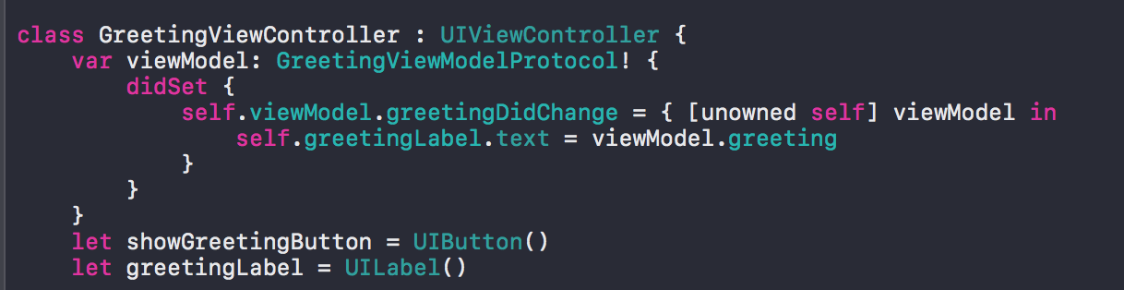
Data binding
Data binding for Swift 3: didSet

Slide 22
Example…
View
Owned
ViewModel
Bind
Button
User-action
showGreeting
Bind
Model
Label
greeting
<String>
Person
“Marquez”
Data
Bind

Slide 23
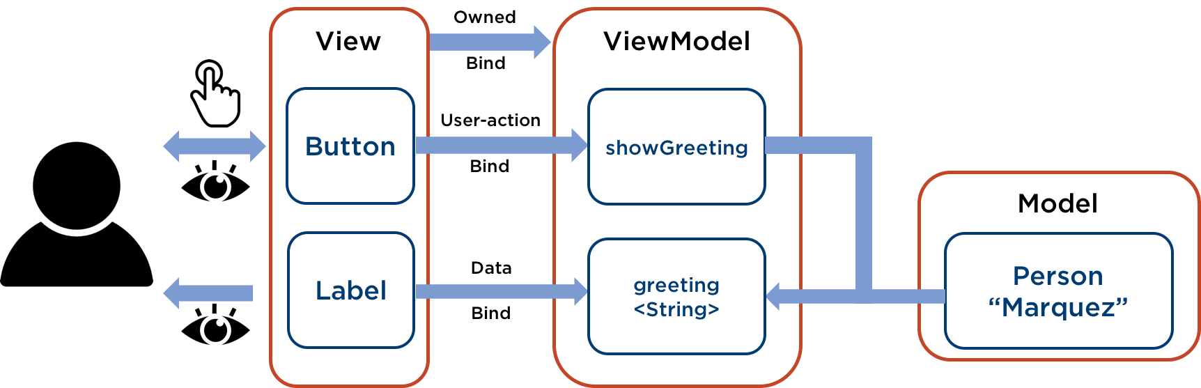
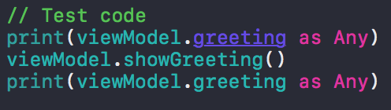
Example…

Slide 24
Example…
No need
To see
For testing

Slide 25
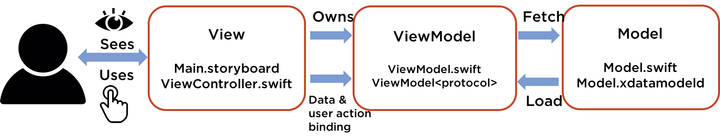
MVVM
Pros
Unit test is more easier (ViewModel doesn’t need to know about view)
No need to make virtual view
Fast-reactive programming model, less code than MVP (because of data-binding)
Cons
View has more responsibilities(view need to update itself)
Complex to express view binding

Slide 26
VIPER (View-Interactor-Presentor-Entity-Router)
Router
Router.swift
Segues between modules
Own & send actions
View
Main.storyboard
ViewController.swift
View<Protocol>
Presenter
ViewPresenter.swift
Presenter<protocol>
View<protocol>
Owns
Interactor
Interactor.swift
Sees
Uses
Update
Notify
Knows about
Entity
Entity.swift
Entity.xdatamodeld

Slide 27
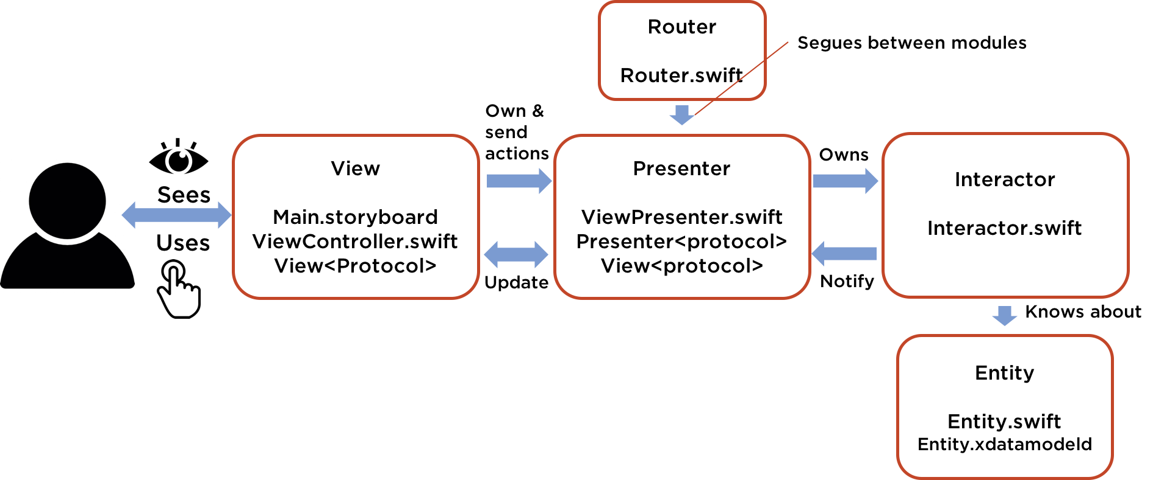
VIPER
Pros
Better distribution, better testability
Very small responsibilities for each class
Cons
Huge amount of interface for classes even for a simple application

Slide 28
Current application
Leak of Test
Unit test
Testing a few logics of Commonframework module
No Unit test for every modules (ex. add appliance cell, network …)
UI test
Testing the behavior with real(virtual) appliances

Slide 29
MVVM is the solution?

Slide 30
MVVM is the solution?
NO..
But let’s try the MVVM architecture a little.

Slide 31
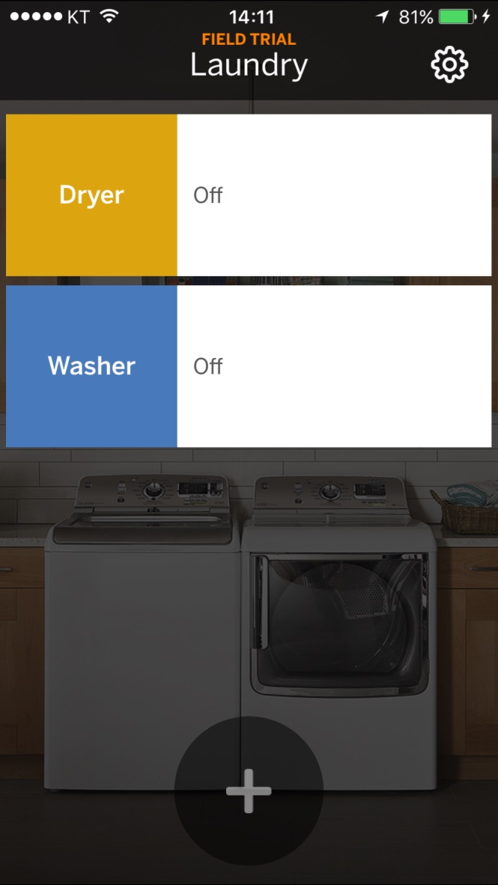
Current Dashboard in Laundry app
View
DashboardVC.xib
Controller
DashboardViewController.h,m
Model
DashboardItemCell
ApplianceManager
Update UIs
AppliancesTableView
DashboardItemCell
AddApplianceButton
UniversalSettingButton
Popup
Move pages
SignInVC
AddApplianceVC
UniversalSettingVC
WasherStatusVC
DryerStatusVC
WasherTroubleshootingVC
DryerTroubleshootingVC
SecurityFailureVC
Network Logics
XmppNetworkLogic
HttpsNetworkLogic

Slide 32
Focus - Simplification for Demo
View
DashboardVC.xib
Controller
DashboardViewController.h,m
Model
DashboardItemCell
ApplianceManager
Update UIs
AppliancesTableView
DashboardItemCell
AddApplianceButton
UniversalSettingButton
Popup
Move pages
SignInVC
AddApplianceVC
UniversalSettingVC
WasherStatusVC
DryerStatusVC
WasherTroubleshootingVC
DryerTroubleshootingVC
SecurityFailureVC
Network Logics
Https
Xmpp

Slide 33
Focus - Demo: Appliances Table using DashboardItemCell
View
DashboardVC.xib
Controller
DashboardViewController.h,m
Model
DashboardItemCell
ApplianceManager
Update UIs
AppliancesTableView
DashboardItemCell
AddApplianceButton
UniversalSettingButton
Popup
Move pages
SignInVC
AddApplianceVC
UniversalSettingVC
WasherStatusVC
DryerStatusVC
WasherTroubleshootingVC
DryerTroubleshootingVC
SecurityFailureVC
Network Logics
Https
Xmpp
DashboardItemCell
Appliances
Table

Slide 34
Refactored Dashboard with MVVM
View
DashboardVC.xib
DashboardViewController.h,m
ViewModel
DashboardViewModel.h,m
Model
DashboardModel.h,m
DashboardItemCell
ApplianceManager
Move pages
AddApplianceVC
UniversalSettingVC
WasherStatusVC
DryerStatusVC
WasherTroubleshootingVC
DryerTroubleshootingVC
SecurityFailureVC
Update Models
DashboardItemCell
Update Models
DashboardItemCellArray
Update UIs
AppliancesTableView
AddApplianceButton
UniversalSettingButton
Popup
Network Logics
Https
Xmpp

Slide 35
MVVM design for showing ApplianceList table
View
Owned
ViewModel
Model
Bind
DashboardVC
requestNetworkList
ApplianceManager
update
update
UITableView: UITableViewCell
Array <DashboardItemCell>
Add to Array
DashboardItemCell
<Dryer, Washer>
Data
Bind

Slide 36
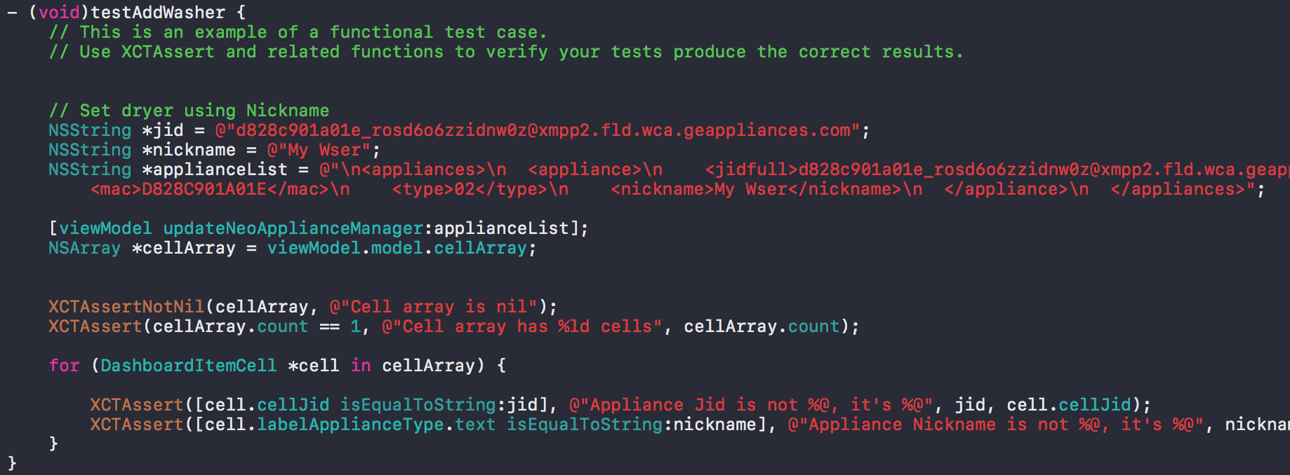
Test code

Slide 37
End

Slide 38
References
https://en.wikipedia.org/wiki/Model%E2%80%93view%E2%80%93controller
https://medium.com/ios-os-x-development/ios-architecture-patterns-ecba4c38de52#.b5a5de26b
https://github.com/mutech/aka-ios-beacon
https://github.com/ReactiveCocoa/ReactiveCocoa

